Slide 1
TransPAC Measurement & Performance Activities
APAN 39 - Fukuoka
Andrew Lee
Network Engineer
University Information Technology Services
Indiana University
leea@indiana.edu
INTERNATIONAL
NETWORKS
At Indiana University
Supported by the National Science Foundation
Notes:
Opinions are mine. Don’t know how long this will be. Title of the talk is misleading – our activities boil down to: we deployed a server and want to use it better. I want to take this opportunity to bring to the forefront a discussion I have heard in the background about the use of perfSONAR in APAN and try to find out what the obstacles are. Much material is repeated from previous days

Slide 2
Outline
Brief overview of perfSONAR
TransPAC hardware and other updates
Observations

Slide 3
Brief overview of perfSONAR

Slide 4
perfSONAR
perfSONAR is:
a suite of tools that will help you watch for network problems
continuing to be developed and improved
a well supported tool with a good community
perfSONAR isn’t:
a magical oracle that will instantly tell you what is wrong with your network
like a toaster
Notes:
Yes most performance problems are at the edge, or at least campus, but some are not
Automated tests – bandwidth, latency, loss – also manual tests. Good for me - due to time shift
You have to be able to establish a base line for normal
You have to care/feed

Slide 5
Examples
So what can perfSONAR show me and why does it matter?
The following slides are not mine, but are borrowed with permission
See http://www.perfsonar.net/about/training-materials/ - especially http://www.perfsonar.net/media/cms_page_media/3086/20150121-perfSONAR-5-Use_Cases-v3.pptx

Slide 6
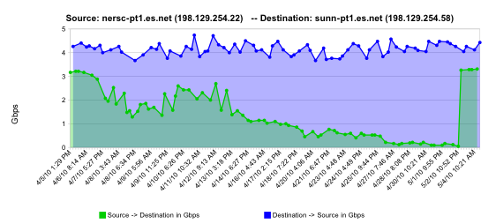
Success Stories - #1 Failing Optic(s)
Second example – another one featuring a backbone
Similar to frog boiling, hard alarms don’t notice gradual failure
normal performance
Gb/s
degrading performance
repair
one month

Slide 7
Success Stories - #1 Failing Optic(s)
Throughput vs. increasing latency on a 10Gb/s link with 0.0046% packet loss
Local
(LAN)
With loss, high performance beyond metro distances is essentially impossible
International
Metro Area
Regional
Continental
Measured (TCP Reno)
Measured (HTCP)
Theoretical (TCP Reno)
Measured (no loss)
September 9, 2015
Notes:
RTT nms1.jp.apan.net to test.losa.transpac.org is 115ms

Slide 8
Success Stories - #2 Brown University Example
Results to host behind the firewall:
Notes:
3 reasons to look at this – 1) yes firewalls cause problems 2) dips in graphs aren’t problems, network is in use 3) 10g hosts are good to have, but 1G testers are useful too

Slide 9
Success Stories - #2 Brown University Example
In front of the firewall:

Slide 10
Wide Area Testing – Full Context
Notes:
This is the user perspective with full routed network context (optical transport omitted)

Slide 11
Wide Area Testing – Long Clean Test
Notes:
The long clean test identifies a portion of the infrastructure that is likely not the problem
Note that short-distance tests do not identify clean components!!!

Slide 12
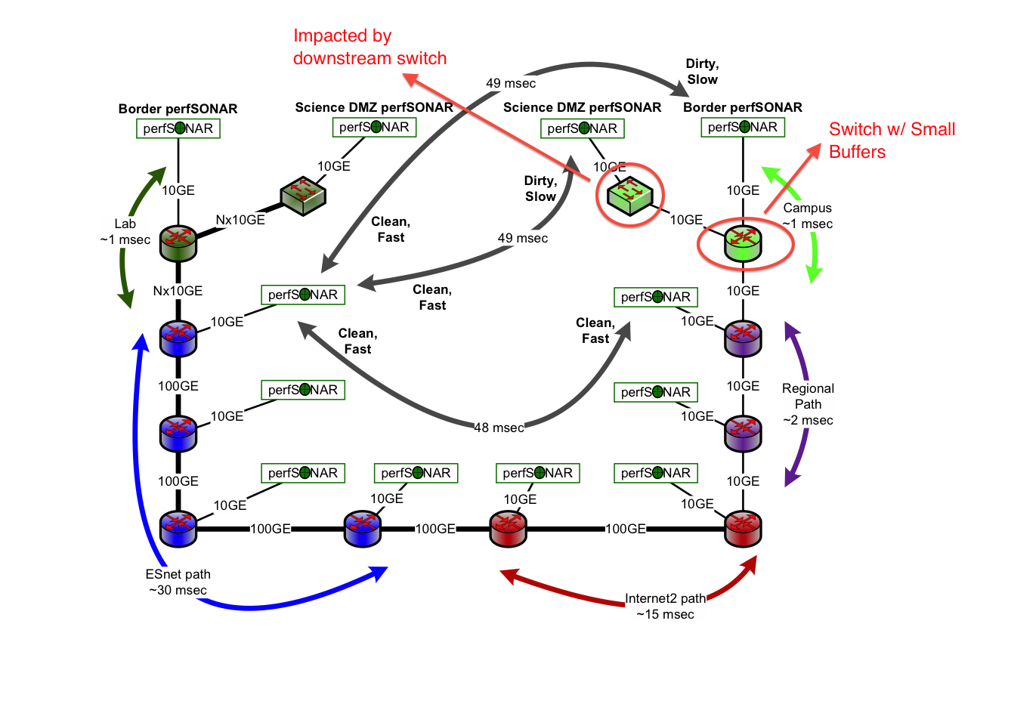
Likely Problem Area
Notes:
Test as much of the wide area path as you can – this gives the test similar TCP dynamics to the real traffic
From a single remote test host, using as much of the path as possible, run the longest clean test you can and the shortest dirty test you can that includes the path of the long clean test.

Slide 13
TransPAC hardware and other updates

Slide 14
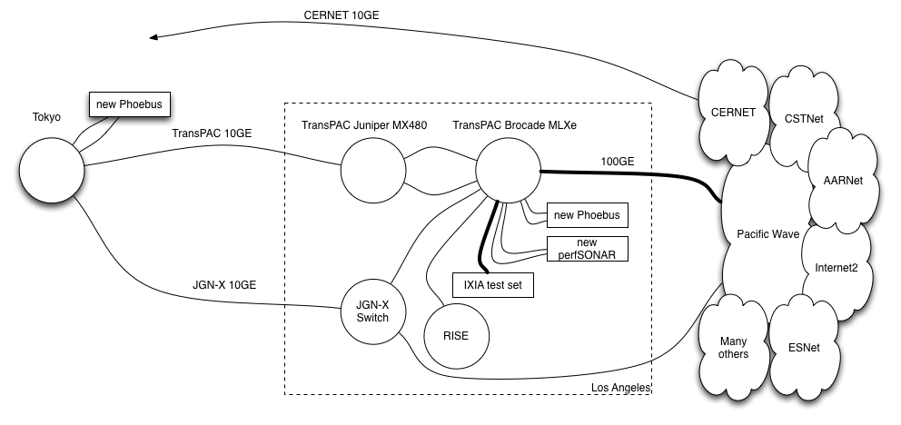
Los Angeles POP Upgrade
Notes:
New perfsonar node replaces nms6

Slide 15
PerfSONAR in Emerging Regions
Partnering with NSRC and ESnet
Help expand the number of perfSONAR deployments was part of the work proposed
Two-pronged approach
Training for network engineers
Hands on exercises
Development of additional materials including videos
Equipment for perfSONAR nodes, including installation assistance

Slide 16
Equipment and Installation
Work with NRENs in emerging regions
Goal is to get one perfSONAR node in every POP in each of the selected NRENs
Hardware and assistance to install
Provide equipment to emerging NRENs
Send engineers to remote NREN to provide some hands on help and assist with installation
Initial “trial” with two NRENs
Kenya
PREGINET

Slide 17
perfSONAR consortium
Group of organizations committed to developing the perfSONAR product
ESNet
GEANT
Indiana University
Internet2
http://www.perfsonar.net

Slide 18
Observations

Slide 19
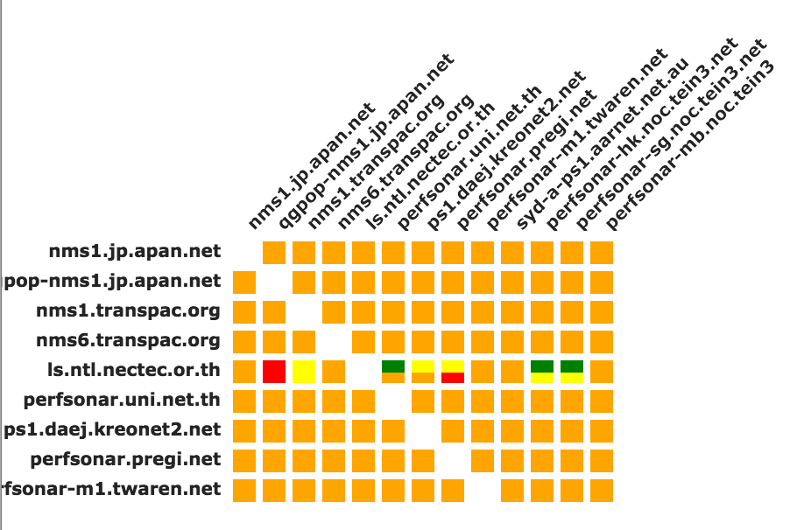
MADDASH - APAN
Notes:
APAN maddash

Slide 20
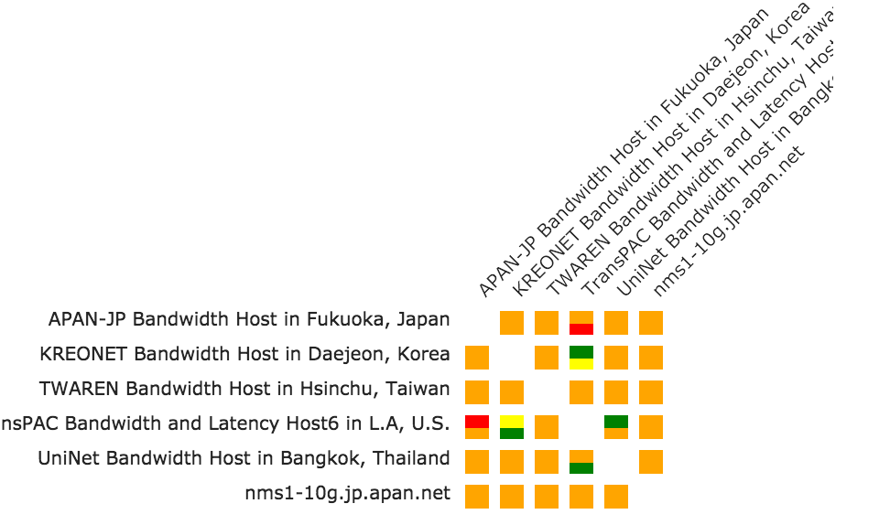
MADDASH - TransPAC
Notes:
TransPAC maddash

Slide 21
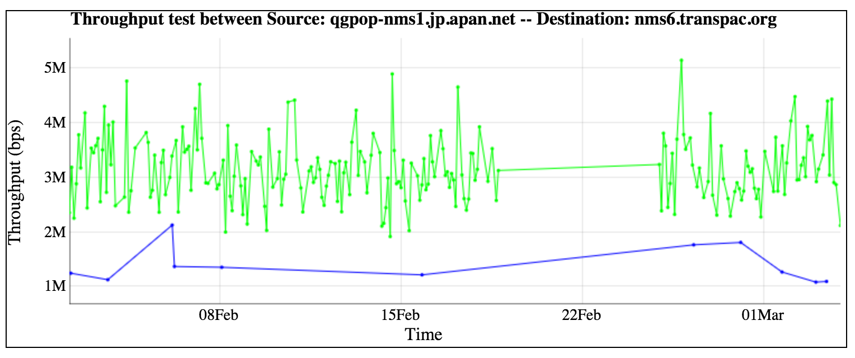
Notes:
Fukuoka

Slide 22
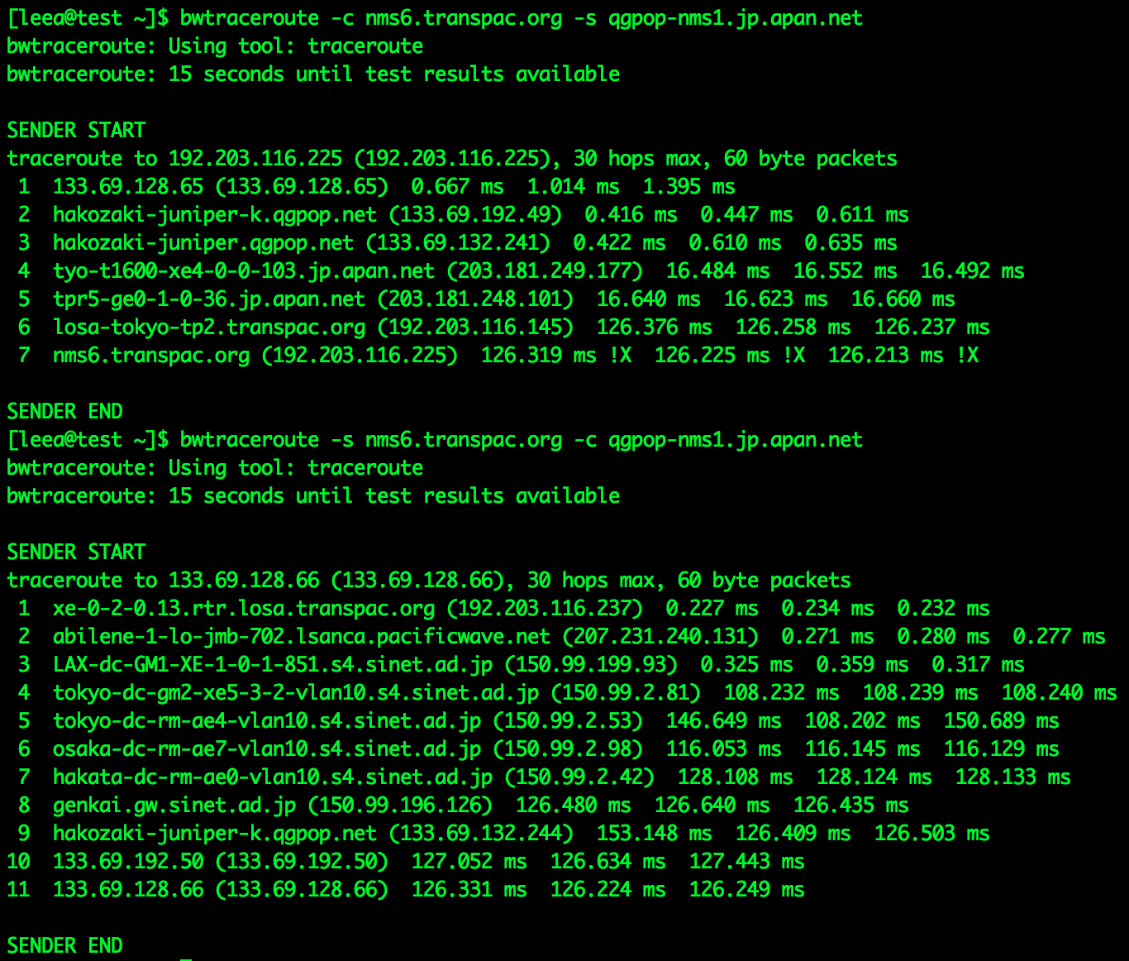

Slide 23
Conclusion
I would like to see more perfSONAR deployment in the region
I would like to help figure out how
Thank you
Andrew Lee
leea@indiana.edu
Notes:
perfSONAR - useful
In US – NSF funds PS deployment – Kevin/Bill
Training – esnet/internet2 does – talk about doing sometihng at next APAN
Don’t need to wait – lots of prep work, many already know how – not easy but not hard (just takes time/effort investment)

