Slide 1
Denial of Service Mitigation
with OpenFlow and SciPass
Hans Addleman
TransPAC Engineer, International Networks
University Information Technology Services
Indiana University
addlema@iu.edu
INTERNATIONAL
NETWORKS
At Indiana University
Supported by the National Science Foundation

Slide 2
Goals
Provide adequate security at 100Gbps speed
Detect Distributed Denial of Service (DDOS) attacks
Stop attack inside the Wide Area Network (WAN)
Automated process
Do not impede legitimate traffic

Slide 3
Intrusion Detection System
Deep packet inspection
Look for known traffic patterns and signatures that signal an attack
Useful for identifying DDOS
Notes:
There are many Intrusion detection systems. They allow for deep packet inspection and can trigger on traffic patterns that may signal an attack. The traffic patterns can be manually set or more helpfully look for known signatures. Once the IDS identifies bad traffic it can signal another action. Typically at this point some human intervention may be required to put manual blocks in place.

Slide 4
SciPass
Indiana University developed SDN Application
Adaptive IDS cluster load balancing
Reactive white and blacklisting
Web Service API for IDS Feedback
Designed primarily for Science DMZ

Slide 5
Background: Campus Networks
Campus Networks
Firewalls
May not be large flow optimized
There may be a better path for science / research traffic.

Slide 6
Background: ScienceDMZ
Support high performance science applications
Reduce loss that impacts TCP performance
faster / bigger connection to regional / national / international networks
Integrate and allow for test points
Provide some security at 100Gbps
https://fasterdata.es.net/science-dmz/

Slide 7
SciPass: Approach
Create a Reactive System
OpenFlow Switch
Intrusion Detection
PerfSonar
Default traffic to slow path
Use IDS to detect what goes on fast path

Slide 8
SciPass: Default
Traffic follows default path
Traffic mirrored to array of Intrusion Detection Systems.

Slide 9
SciPass: Detection
IDS identifies science / defined flow
IDS signals SciPass to setup fast path

Slide 10
SciPass: Bypass
Based on IDS input SciPass installs OpenFlow rules to bypass the firewall / take best path.

Slide 11
SciPass Blacklist Feature
Can match:
Source / Destination IP
Source / Destination Port
Ethernet Type
SciPass sends OpenFlow rules to switch
Flow Based: Block HTTP traffic from Host A to B
Prefix Based: Block all traffic to 192.168.0.1/32
Prefix Based: Block all traffic to or from 192.168.1.0/24
IDS signals bad traffic to SciPass via web services

Slide 12
Mitigation
IDS detects malicious traffic
IDS signals SciPass to block traffic
SciPass creates openflow rules on switch to block traffic.

Slide 13
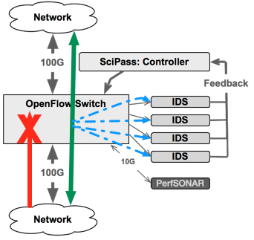
SciPass Black List Example

Slide 14
Path Forward
Lab Deployment
SciPass + Brocade MLXe + IDS (Bro)
Generate test traffic
Squash false positives
Feasibility / Scale
TransPAC4 Field Deployment in logging mode
TransPAC4 Field Deployment in automatic mode

Slide 15
Questions / Comments?
http://globalnoc.iu.edu/sdn/scipass.html
http://internationalnetworking.iu.edu
Hans Addleman - addlema@iu.edu
TransPAC4 NSF IRNC Award: #1450904

