Slide 1
TransPAC:
More than a Network
Dr. Jennifer M. Schopf
Director, International Networking
Indiana University
jmschopf@indiana.edu
March 3, 2014
Notes:
Intro Slide

Slide 2
Overview
The Next 5 years of TransPAC in a nutshell
How circuits may change
LA Upgrade
Monitoring
Applications and support
Other IU work in this area
http://internationalnetworking.indiana.edu/

Slide 3
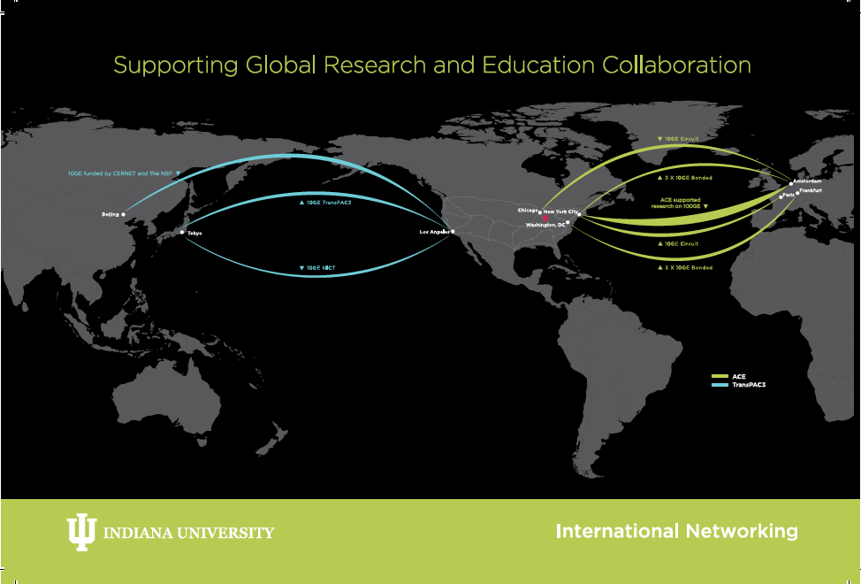

Slide 4
TransPAC Today
15+ year history
Cooperative partnership among Indiana University, APAN, TEIN*CC, JGN-x/NICT-Japan, NII-Japan, CERNET, and others
30Gbps deployed between US and Asia
  10Gbps LA-Tokyo funded by NSF
  10Gbps Tokyo-LA funded by NICT
  10Gbps LA-Beijing funded by CERNET+NSF

Slide 5
Current TransPAC3 Projects
Deployment of measurement tools
Deployment of dynamic circuit services
Development of SDN (OpenFlow) services
Support for application end-users
In Year 5 of 5 year award
  Runs through May 2015

Slide 6
We have been awarded
TransPAC4: Pragmatic Application-Driven International Networking
To run March 2015-Feb 2020
$4.8M over 5 years
Includes funding for circuits, exchange points, application support, research
Press Release: http://itnews.iu.edu/articles/2015/iu-globalnoc-wins-4.8-million-asia-pacific-networking-grant.php

Slide 7

Letters of Support From:
TEIN
APAN
DANTE
NICT
NII
CERNET
SingAREN
Academia Sinica
But we’d love to have more partners!
INTERNATIONAL
NETWORKS
At Indiana University
INTERNATIONAL
NETWORKS
At Indiana University
9/9/15
7
9/9/15
7

Slide 8
System Design
Built-in redundancy and alternative paths
Easy transition from the current TransPAC3 circuits
Complementary paths and approaches to our partners’ sister circuits
Full support of production traffic
Ongoing support for experimental traffic
Fiscally responsible approaches
Two Phase Approach

Slide 9
TransPac4 Phase 1 (2015-2016)

Slide 10
TransPAC4 Phase 2 (2017-2019)

Slide 11
Why not propose 100G in Year 1?
Price tag: $2-3M per year, just for the circuit
A year of the ANA-100G link has shown that the technology may not be fully stable yet
Current Asian inter-country connectivity not yet 100G in many cases
Few applications require more than 10G flows right now
Few exchange points are ready for this now
That said – we’ll evaluate all proposals that come in when we do bids

Slide 12
Transport
Support for Layer 3 peering
Multiple mechanisms for dynamic Layer 2 circuits

Slide 13
Experimental work
Software Defined Networking and InterDomain Controllers
  What do applications really need here?
  How can we support a production infrastructure?
  How can we move beyond special set-ups for demos?

Slide 14
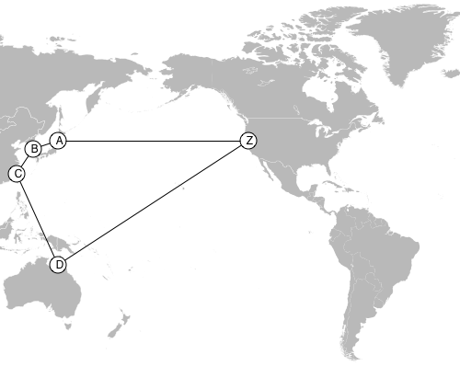
BGP Path Hinting
Inject additional metadata into the BGP routing table to help networks make more informed decisions about the best way to handle traffic

Slide 15
End User Engagement
Directly engage with user communities
Focusing on end-to-end performance
Application Advocacy Specialists will work closely with end users with network needs
  including US branch campuses in Asia
We’ll talk about this more later….

Slide 16
TransPAC4 at 100,000 feet
We’re not building a network simply to create a network
We’re building a communication paths to support science and research

Slide 17
Questions? Comments?

Slide 18
TransPAC3-TransPAC4 Transition
Need to maintain support for current commitments
Some upgrades have been started as part of TransPAC3

Slide 20
TransPAC3-TransPAC4 Transition
Current LA-Tokyo NSF funded link is extended through August
JGN is continuing theirs as well
CERNET link will be supported by I2, as agreed when it was set up

Slide 21
Phase 1 New Links
We will be bidding for new links in April-May
We had proposed
  Phase 1 (2015-2016)
    10G LA-Japan
    10G Seattle-??
  Phase 2 (2017-2020)
    100G upgrades
That said, we’re really dealing with a funding limit so if we could do 100G sooner with the funds we have we would

Slide 22
How Will A New Link Be Chosen?
Budget
Route need
Redundancy
Open Exchange End Point

Slide 23
Open Exchange Points
Based on the IREN definition
  https://fasterdata.es.net/nsf-iren/
Operated by the countries and/or ]NRENs in which they are located.
At least two connections to the Backbone for redundancy and reliability
Allow additional international links to NRENs, aggregators, and regional consortia
Provide an experimental platform
Provide layer 1-3 connectivity services with policies supporting bi-lateral peering at layers 2-3
Share measurement and monitoring data (active and passive)
Have a “reasonable” cost model

Slide 24
Peerings and Routes
Many links are growing and changing
Will need to be updated
Suggested venue? Timing?

Slide 25
Comments?Questions?

Slide 26
What have we started on
Los Angeles POP update
Additional data collection
100G tester deployment

Slide 27
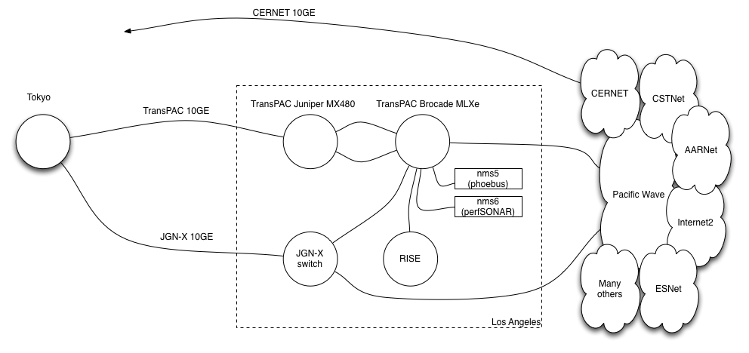
Current Los Angeles POP Layout

Slide 28
Los Angeles POP upgrade
Installation of IXIA 100G test set
Upgrade of Pacific Wave connection to 100G
  With multiple 10G links, there is possibility of exceeding 10G traffic
  Also need to support new Seattle POP
Update Servers
  perfSONAR
  Phoebus
Increase flow data capabilities

Slide 29
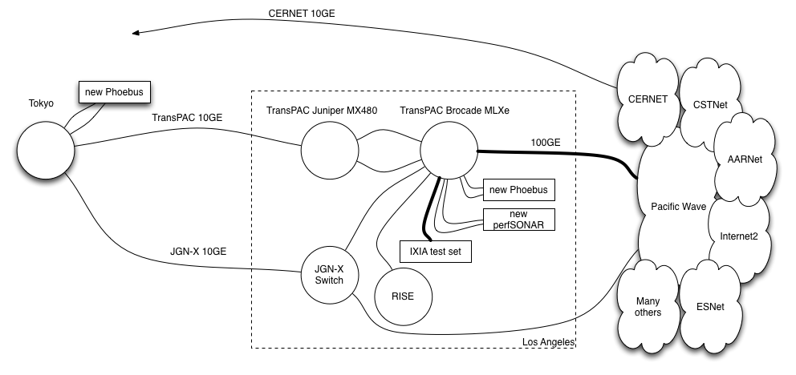
Los Angeles POP Upgrade

Slide 30
Architectural ideas
These are not set in stone
Discussion with our partners about:
  ION decommission
  Increased support for SDN
    FSFW
    Other SDN experimentation
  Topology changes
  Termination point for 2nd TransPAC link

Slide 31
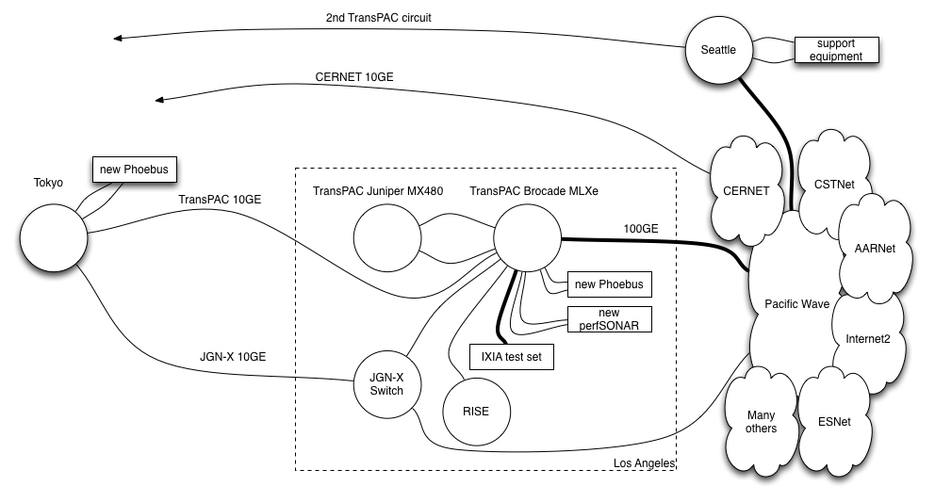
Architectural ideas

Slide 32
Measurement and Monitoring
Active and Passive data collection
  Upgraded infrastructure to collect flow data
  Continued use of GlobalNOC tools such as SNAPP
Wednesday 2pm – Network Engineering Session
  “TransPAC Measurement & Performance Activities”
Notes:
SNAPP for transpac rtr is 10 seconds

Slide 33
100G Ixia Tester
IXIA XM2 tester with 100G module
Available for use by anyone who wants to use it
  VLAN across PacificWave
  Physically rehome

Slide 34
Comments?Questions?

Slide 35
A Couple Related Projects

Slide 36
PerfSonar in Emerging Regions
Partnering with NSRC and ESnet
Help expand the number of perfSONAR deployments was part of the work proposed
Two-pronged approach
  Training for network engineers
    Hands on exercises
    Development of additional materials including videos
  Equipment for perfSONAR nodes, including installation assistance

Slide 37
Equipment and Installation
Work with NRENs in emerging regions
Goal is to get one perfSONAR node in every POP in each of the selected NRENs
  Hardware and assistance to install
  Provide equipment to emerging NRENs
  Send engineers to remote NREN to provide some hands on help and assist with installation
Initial “trial” with two NRENs
  Kenya
  PREGINET

Slide 38
Right-sizing the hardware
Emerging NRENs often have different characteristics
  1Gbs and lower link speeds in backbone
  POPs sometimes are very space limited and might not even have 4-post racks
  POPs can be power limited
Don’t want and don’t need same level of hardware we might use elsewhere

Slide 39
IRNC Monitoring: NetSage
Joint project with UC Davis, Esnet and U. Hawaii
Open, privacy-aware, network measurement, analysis, and visualization service
Designed to address the needs of today’s international networks
Active and passive measurements over IRNC Backbones and Exchange Points
Focus on privacy issues
Better visualization services

Slide 40
3 NetSage use cases
1) Current traffic patterns across IRNC links, and the ability to anticipate growth trends for capacity-planning purposes;
2) The main sources and sinks of large, elephant flows to know where to focus outreach and training opportunities; and
3) Where packet loss is occurring, whether the cause is congestion or other issues, and what impact it has on end-to-end performance.

Slide 41
IRNC NOC
Single, centralized NOC for IRNC funded infrastructure projects
  A 24x7x365 NOC
  Focus on proactive response,
  Rich and transparent operational reporting,
  End-to-end performance engagement.
GlobalNOC Service Desk as centralized first point of contact
  End-to-end performance assessment/triage
  Pass Tier II and Tier III issues to the awarded infrastructure projects’ engineering personnel
  Coordinating problem resolution lifecycle from start to completion.

Slide 42
More than just a NOC
IRNC End-to-end Performance Engagement Team (e2e PET)
  Cross-network performance assurance team, the
  End-to-end performance analysis and troubleshooting
  Support data-intensive science projects
Team will be staffed by subject matter experts

Slide 43
Status
Hope to know official status of these 2 proposals before the Global Summit (April)

Slide 44
Take Away Message
TransPAC4 is more than just circuits
  End user support is criticial
IU is more than just TransPAC
Looking forward to working with all our partners!

Slide 45
Questions/Comments?
Take aways:
  TransPAC4 is more than just circuits
  Looking forward to working with all our partners!
  We have resources especially to work with people transferring data to the US
Group Website:
http://internationalnetworking.indiana.edu/
Jennifer Schopf – jmschopf@indiana.edu
Andrew Lee – leea@indiana.edu

